Slide 1

Module 6: SMA-X Incident Mgmt
Jan 2018
Notes:
[STANDARD SLIDE: L300 (animated)]
You can change out the photo with any image from Getty Images in DropBox.
The module number is listed in the title and explicit instructions for downloading the PPT are mentioned in the notes.
You may have to adjust the title font size or increase the size of the text box to make things fit.
You may have to move the title text around depending on the photo. Make sure the text is readable against the background photo.
You can change the background color for the rectangle in the bottom-right corner to look better against the background. Choose a Micro Focus color at 25% transparency.
=========================
Note to Narrator or Reader: [PRESS] indicates press the Page Down key to show the animation
=========================
Hello and Welcome to Module X of [COURSE_NAME] Technical Overview Training, Level 300.
[If this is the first module, mention: “There are X modules in this course that explore detailed technical information about PRODUCT_NAME”]
In this course you’ll gain a high-level understanding of the essentials of [PRODUCT_NAME].
[PRESS] If you want to download this presentation and save it on your own system, click the Tools & Help icon in the bottom-right corner of your window and select Download.
Or, if you want to access the PPT slides and speaker notes for future reference, go to the Attachments tab in your window and click to download the presentation. This is very useful when you later prepare for the comprehensive Certification Exam.

Slide 2
Objectives
After completing this module, you should be able to:
Describe key features of Incident Management
Escalate a Request to an Incident
Explain Incident Models and Task Plans

Slide 3
Overview

Slide 4
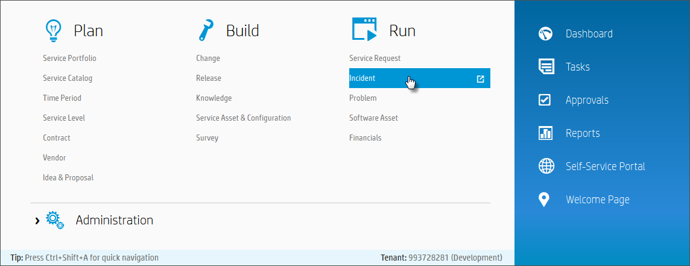
IT Agent Accessing Incident Management
Mega Menu > Run > Incident

Slide 5
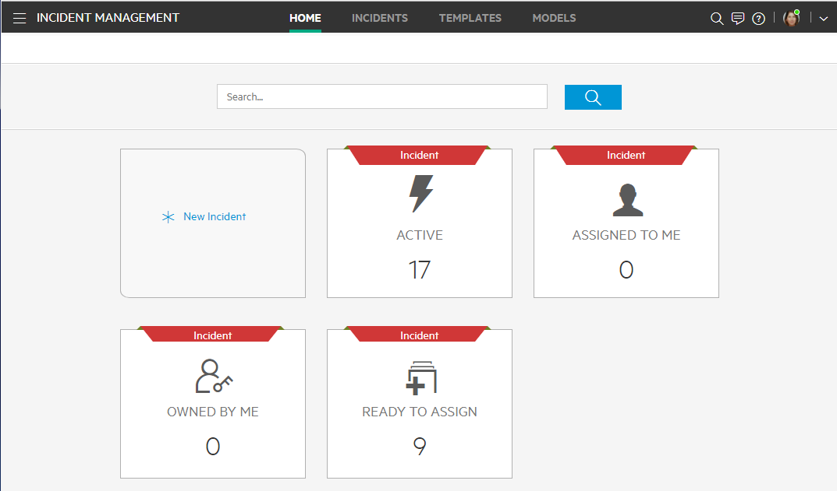
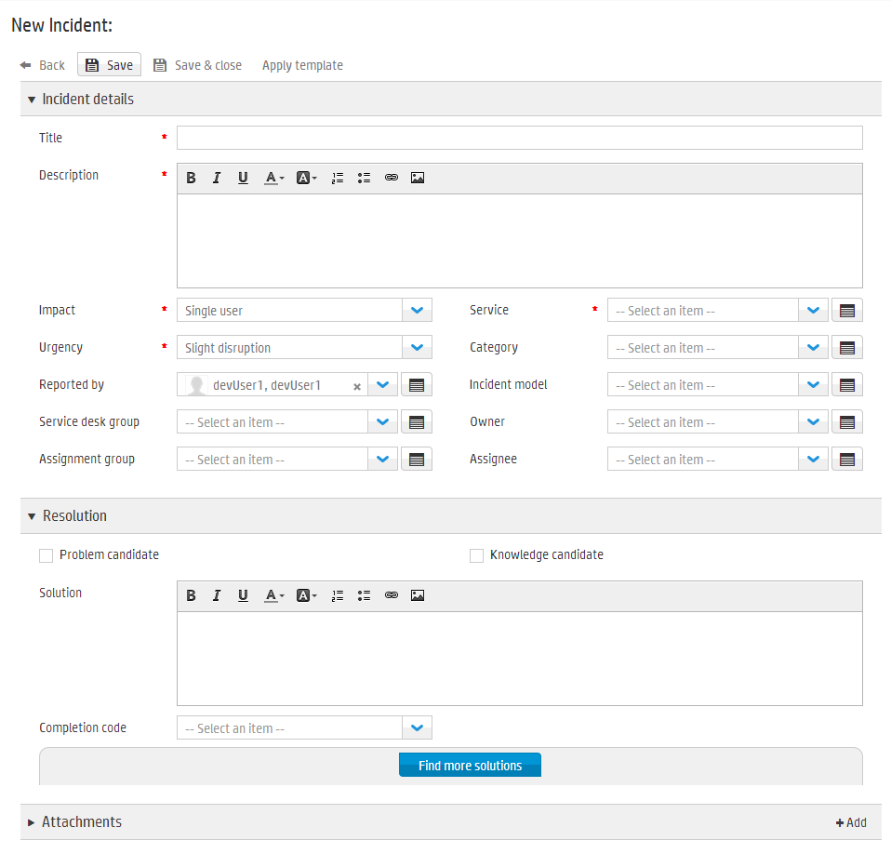
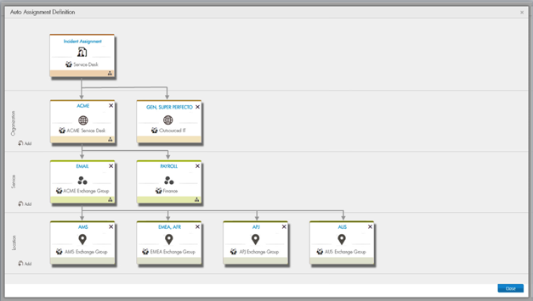
Incident Management Overview
Incident Landing Page
Full text search and Incident Favorite Inbox widgets
Event Feed View gives visibility to records of interest to the user
Suggested Solutions
Leverage knowledge, related solutions, and matching incident/problem records when opening a new Incident
Integrated Request and Process
Cascade incident resolution to its dependent related requests and set the completion code
Advances the related requests to the Accept phase to capture end user feedback on Incident resolution
Auto-close incidents based on solution acceptance by end users
Assignment Engine
Decision tree driven automatic group assignment
Suggested group highlighted when making manual assignments

Slide 6
Landing page
Search incident on Id, title or description
New incident shortcut
Widget links to the incidents page and apply selected filter
The landing page for incident management includes several features that give easier access to the incidents of primary importance to the organization
Notes:
Incident Management Landing Page
The landing page for Incident Management includes the following features that give you easier access to the incidents you are most interested in seeing.
Full text and integer search
Event feed
Direct widget links to favorite filters
Active incidents
Owned by me
Assigned to me
Ready to assign
Incident Management Landing Page – Event Feed
The triggers for including an event in a user's event feed include:
Was assigned. Incidents that became assigned or owned by the user.
Assigned to group. Incidents owned by user (but not assigned to the user) that had their assignment group changed.
Changed priority. Incidents assigned to one of the user's groups that had their priority changed.
Became candidate. Incidents assigned to one of the user's groups that became knowledge or problem candidates.
Breached. Incidents assigned to one of the user's groups that had their SLT breached.
The following information is visible for each event:
The Assignee, Owner, or Ass. group of the incident (depending on the event) – after change.
The trigger of the event type as described above.
The Priority of the incident – after the change.
The ID and Title of the incident – as a hyperlink to the full form of the incident to access all its details in the Incidents page.
The time of the event (relative to current time).
Clicking an event row expands the row and displays a list of relevant incident properties that have changed as a result of the event. Events are displayed in time descending order, most recent at the top. A maximum of 50 events are displayed at any time.

Slide 7
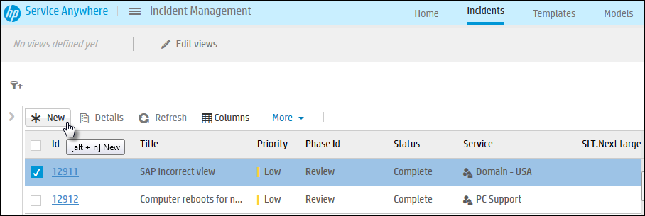
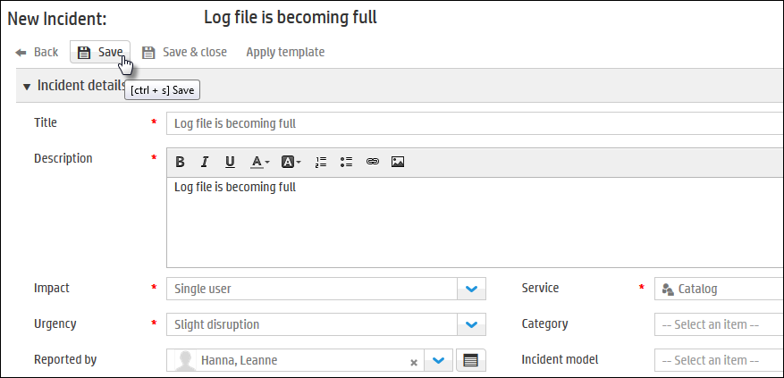
How to Open a New Incident – Recap
A new incident can be opened from Incident List, from within a request or other record
From Incident List, click New button.
In the New Incident form, fill in details and click Save.

Slide 8
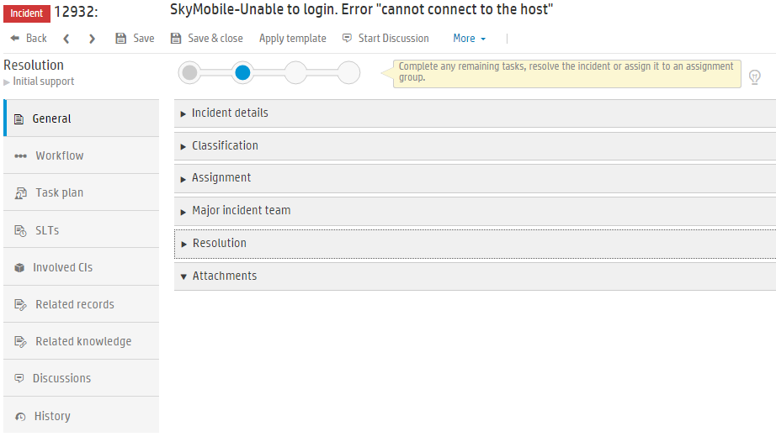
Incident Record content

Slide 9
Templates and models
Incident templates
A Service Anywhere template is a group of pre-populated fields that you can use as a quick start to create a new record or apply to an existing record.
You can create a template with either from an existing incident or create a new one from the menu option
A template cannot create tasks.
Incident models
A model simplifies the creation of a record.
An Incident model pre-populates common fields to save time when you create a new record and select an appropriate model, Service Anywhere automatically populates the relevant fields.
A model can even create the tasks.

Slide 10
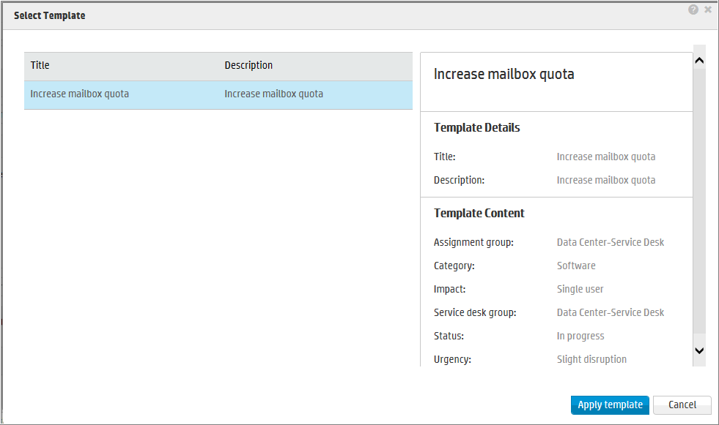
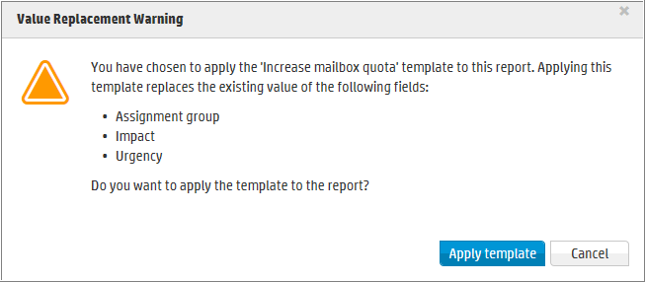
Incident Templates
A template is a group of pre-populated fields that you can use as a quick start to create a new record or apply to an existing record.
Create and Maintain
Incident details
Classification
Assignment
Major incident team
Apply
Value replacement warning

Slide 11
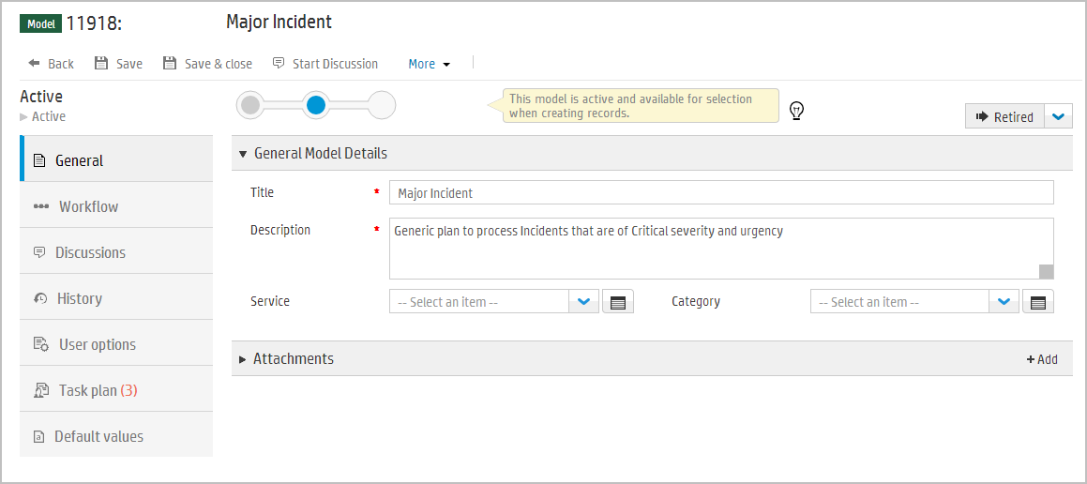
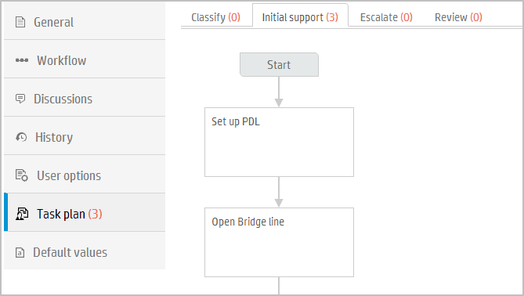
Incident Models
An incident model simplifies the creation of a record.
It pre-populates common fields to save time and standardize input.
A model can contain a Task Plan, so it will create tasks for the incident.
Notes:
Incident models
A model simplifies the creation of a record. For example, when you have common incidents, it is efficient to design a model that you can reuse to simplify the amount of effort required to resolve that same type of incident many times. Models standardize the end-to-end process and maximize efficiency.
A Service Anywhere model pre-populates common fields to save time when you create a new record. When you create a new record and select an appropriate model, Service Anywhere automatically populates the relevant fields. A model can even create the tasks necessary to complete a change request.
Service Anywhere provides a set of default models, and you can add models as required. If you no longer require a model, you can retire that model.

Slide 12
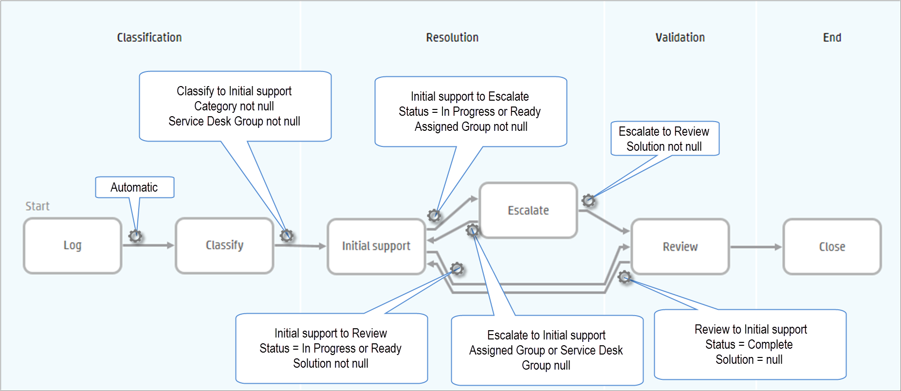
Incident Workflow – Automatic Transitions

Slide 13

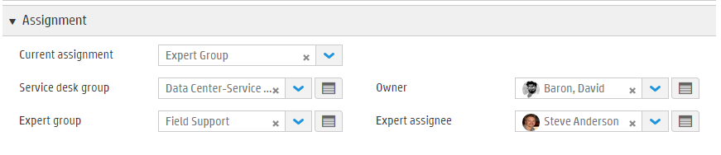
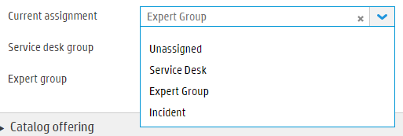
Assignment
Assignment can be based on different kind of rules:
Routing definitions
Groups defined at Actual Service level
Groups related to other fields
Consistent for Request and Incidents
Three pairs of group & person fields
Assignment Group & Assignee
who is currently assigned to the record
Best used on list views and in filter criteria
Not shown on detail pages
Service Desk Group & Owner
Expert Group & Expert assignee
Current Assignment
Possible values of:
Unassigned, Service Desk, Expert Group
Assignment Group & Assignee set based on value
Notes:
Assignment can be based on different kind of rules:
Routing definitions
Groups defined at Actual Service level
Groups related to others
…

Slide 14
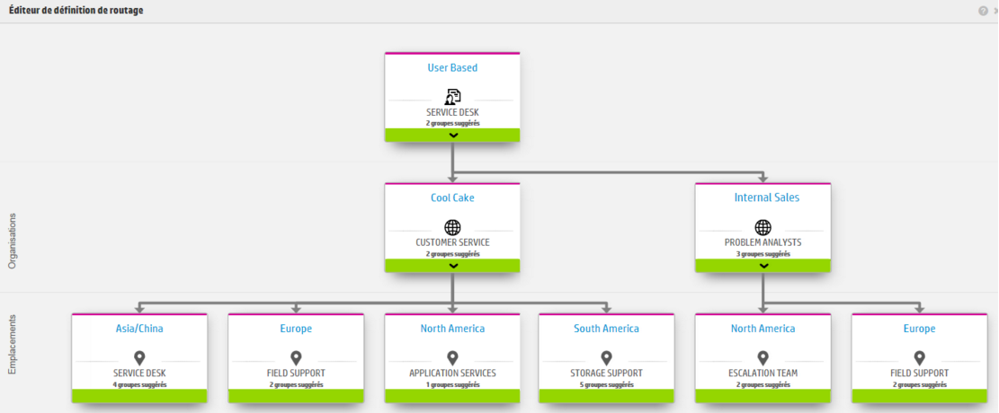
Routing Definition
Routing Definitions can provide Suggested values based on routing definition depending on Service, Organization and/or location
Leverage Big Data auto-suggestions
Assignment fields
Service
Notes:
Routing Definitions can now be used to provide suggestions for the agent when filling in a Group field (in addition being used to set a Group field).

Slide 15
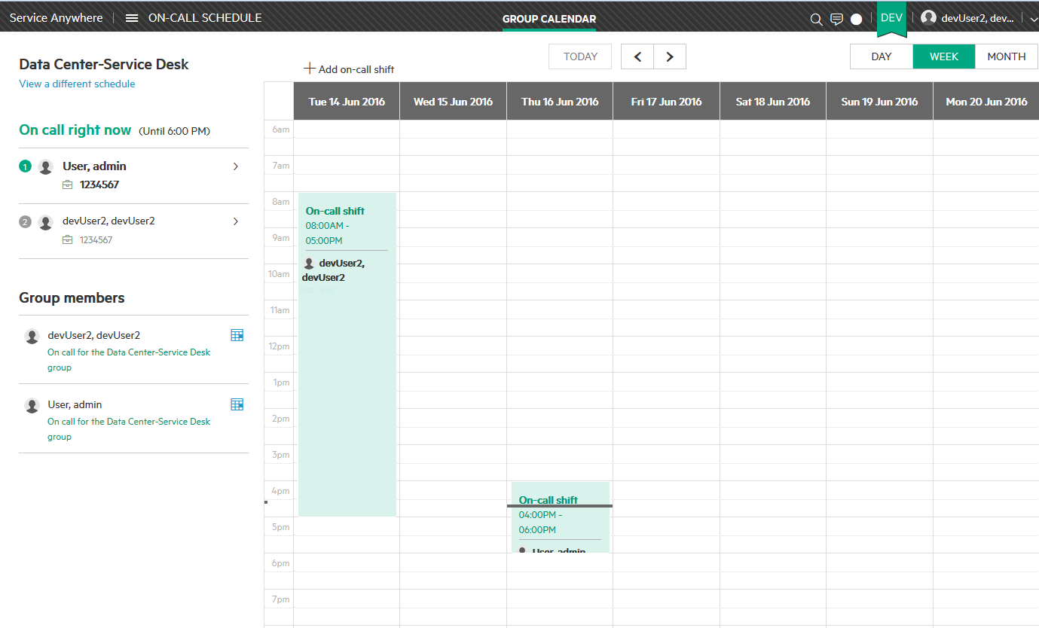
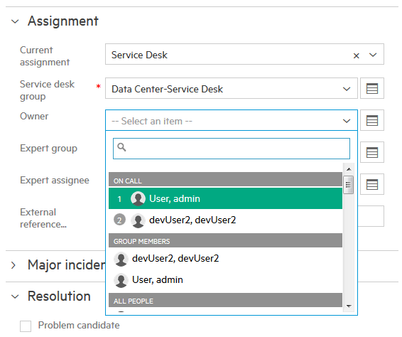
On-Call Schedule Management
Main menu > On-Call Schedule
or
Profile and Preference > Your Group Memberships, select calendar icon
Set On-Call schedules for groups with primary and secondary on-call agents
Select an automated assignment strategy for groups with on-call schedules or use business rules to automatically assign tickets to the current on-call agent
See which agents are On-Call when assigning to a group with on-call members

Slide 16
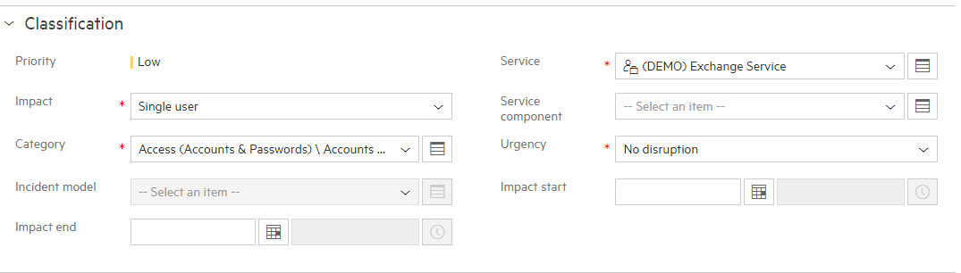
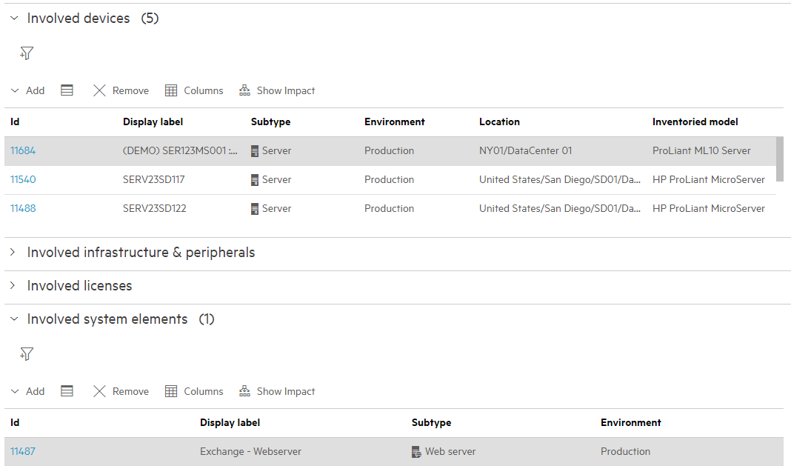
SACM references in Incidents
Classification:
Actual Service
Service Component
Involved CIs tab:
Involved devices
Involved Infrastructure & peripherals
Involved Licenses
Involved system elements

Slide 17
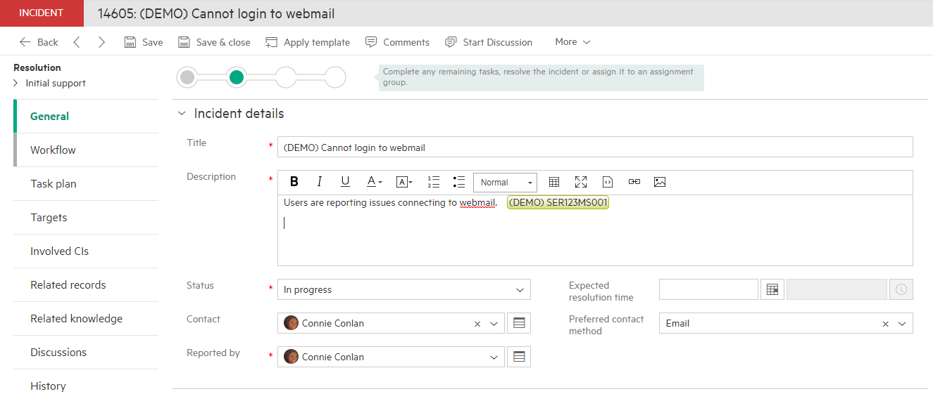
CI Detection
Automatic detection
Analyze content of request/incident description and incident solution
Automatic highlight of asset/Cis in the text
Seamless linking of CI to the ticket
Importance of linking impacted CIs
This helps increase the quality of the ticket, speeding resolution and reducing ticket volume
Helps reduce creation of duplicate tickets for the same asset

Slide 18
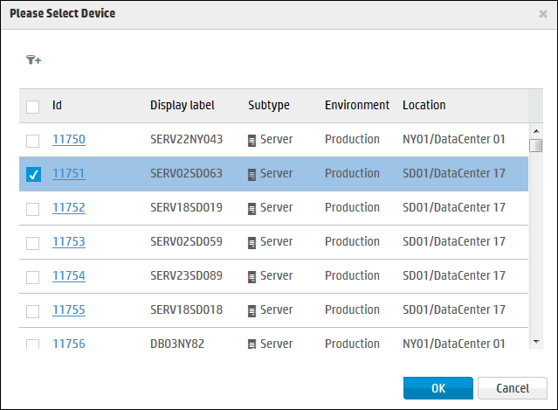
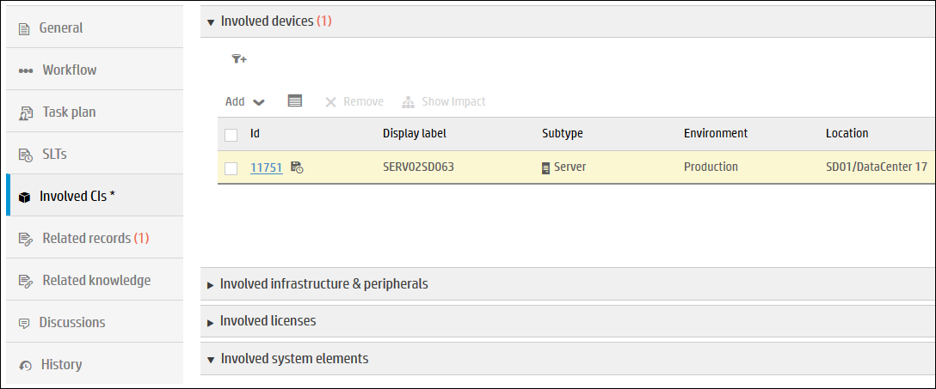
Involved CIs

Slide 19
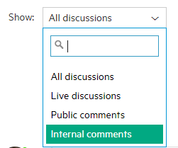
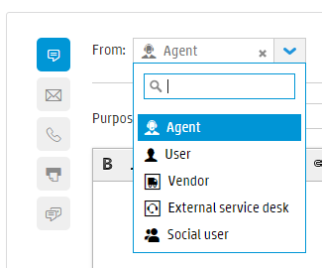
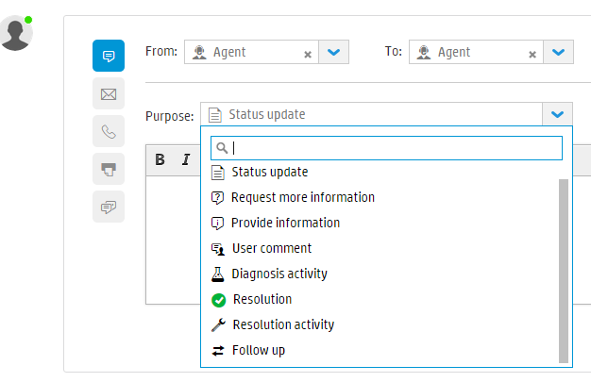
Discussions
Discussions Filters
Post a comment
Discussion Based Events and BR Processing
Enables configurable uses cases
Flag records as updated
Propagate comments from incident to Request
Suspend request depending on Comment’s purpose

Slide 20
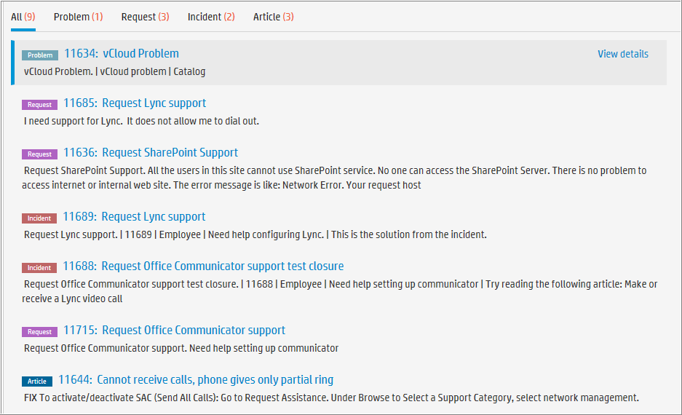
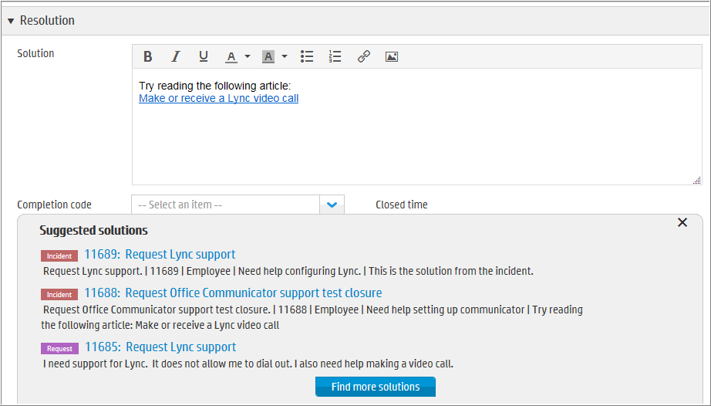
Proactive Solutions
Based on request context: Title and Description
Allows agent to view knowledge
Provide step-by-step instructions
Copy steps or link and send to user
Suggested Solutions
Top three matching Incidents, Problems, Changes or Articles
Find more solutions
More matching Incidents, Changes, Problems or Articles
Notes:
When providing the Solution and saving, the incident will automatically transition to the Review phase

Slide 21
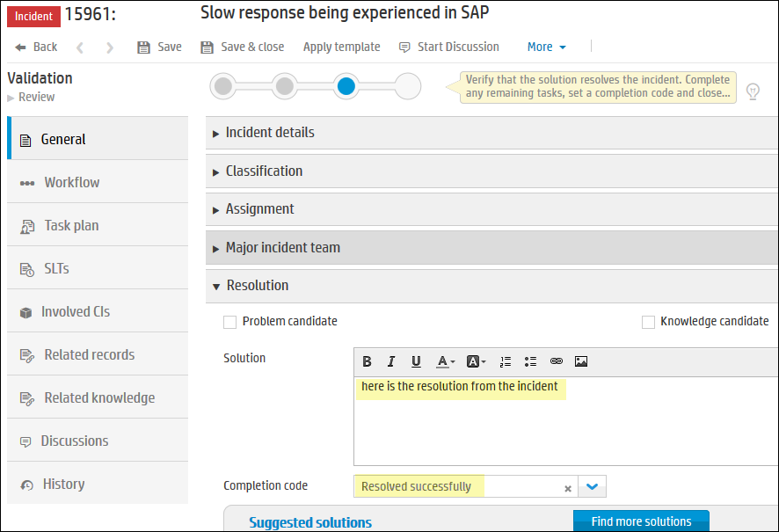
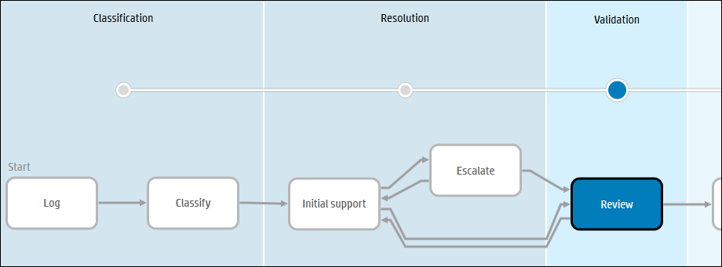
Resolve Incident
After 3 days, incident will be auto closed if all related requests are closed
Once the incident’s Solution is updated, it moves to the Review phase.
The incident moves to the Review phase

Slide 22
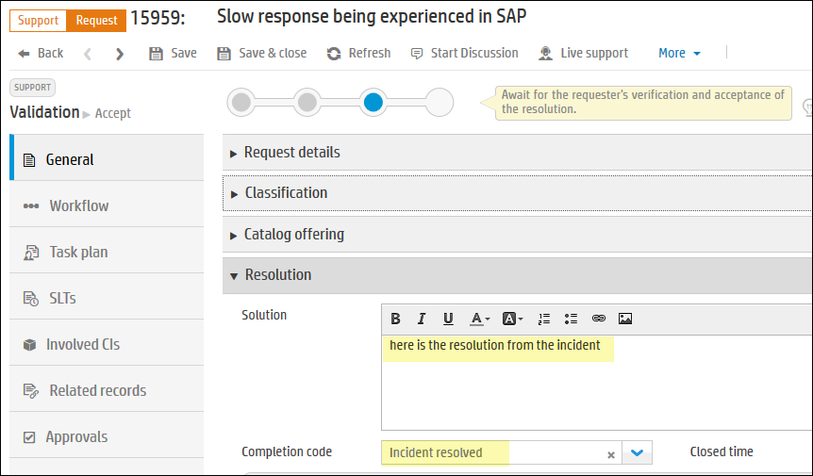
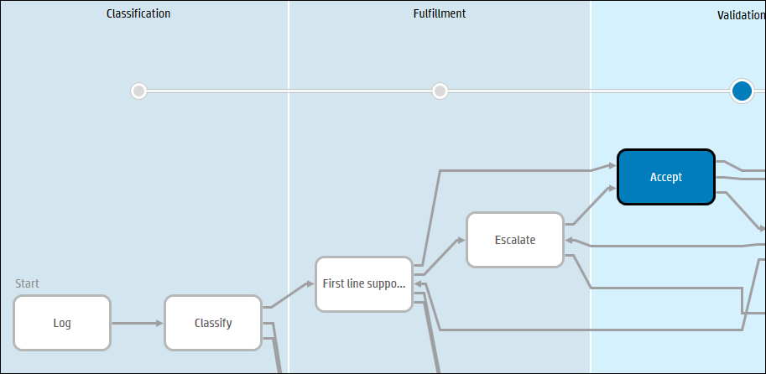
Incident resolution updates related Requests
The incident’s Solution is updated in all related Requests, and Completion Code of Request set to Incident Resolved.
The request moves to the Accept phase

Slide 23
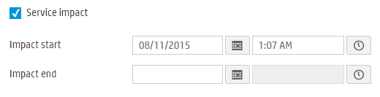

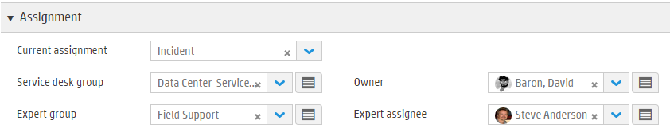
Incident Automatic Creation and Quick Close
Request to Incident flow
Automatic creation of Incident from Request
‘Service Impact’ checkbox field
If checked the request must be linked to an incident
If no incident is linked then one is created
Current Assignment field set to ‘Incident’ to indicate that the request is being worked in the Incident process
Request is no longer assigned
Service Desk Group and Owner are still set
Quick Request Resolve from Incident
Add Solution and set Completion code on the Incident
This will set the Request Solution and Completion code
Incident resolved <- Resolved successfully
Resolved with workaround <- Resolved with workaround
Unable to reproduce <- Not reproducible
Abandoned by user <- Withdrawn by user

Slide 24


Lab Exercises
Incident and Service Level Management Quick Flow Demo Card

